Slide 1
HELAN.K
GESTURE STEGANOGRAPHY
3/21/2024 Annual Review

Slide 2
PROJECT TITLE
GESTURE STEGANOGRAPHY
3/21/2024 Annual Review

Slide 3


AGENDA
Define Gestural Encoding Scheme:
Establish a set of gestures to represent different characters, words, or concepts. This scheme should be intuitive and discreet, allowing for seamless integration into everyday gestures.
Develop Gesture Recognition System:
Create a system capable of recognizing and interpreting the gestures defined in the encoding scheme. This may involve computer vision algorithms, machine learning models, or sensor-based technologies such as accelerometers or gyroscopes.
Design Communication Protocol:
Develop a protocol for encoding and decoding messages using the defined gestures. This protocol should include rules for gesture sequencing, error correction, and security measures to prevent unauthorized interception or decoding of messages.
Implement Steganographic Techniques:
Integrate steganographic techniques to embed messages within the subtle variations of the defined gestures. This may involve modifying the timing, amplitude, or trajectory of gestures to encode binary data discreetly while maintaining the appearance of natural gestures.
Test and Refine System:
Conduct extensive testing to evaluate the robustness, reliability, and security of the gesture steganography system. Iterate on the design based on feedback and real-world testing to optimize performance and usability
3/21/2024 Annual Review

Slide 4

PROBLEM STATEMENT
For Developing a gesture steganography system to conceal sensitive information within subtle hand movements, allowing for covert communication in scenarios where overt communication channels are monitored or restricted.
3/21/2024 Annual Review

Slide 5

PROJECT OVERVIEW
Gesture steganography project aims to design and implement a covert communication system where messages are concealed within subtle hand gestures. By utilizing advanced gesture recognition algorithms and steganographic techniques, the system enables secure transmission of information in situations where traditional communication methods are impractical or compromised. The project involves defining a gestural encoding scheme, developing a robust gesture recognition system, implementing steganographic methods to embed messages within gestures, and testing the system for reliability, security, and usability.
3/21/2024 Annual Review

Slide 6

WHO ARE THE END USERS?
Government Agencies: Intelligence operatives or law enforcement personnel needing covert communication channels in sensitive operations.
Journalists and Activists: Communicating securely in regions with surveillance or censorship, ensuring the safety of sources or sensitive information.
Business Executives: Conducting confidential negotiations or sharing proprietary information discreetly during meetings or conferences.
Military Personnel: Covert communication between units in the field, ensuring operational security and preventing interception by adversaries.
Personal Privacy Advocates: Individuals concerned about privacy breaches or surveillance in everyday communication, seeking alternative secure channels.
Security Professionals: Testing and validating the robustness of communication systems against interception or eavesdropping.
3/21/2024 Annual Review

Slide 7

YOUR SOLUTION AND ITS VALUE PROPOSITION
Gesture steganography offers a unique method of covert communication by embedding messages within subtle hand movements. This solution involves developing a robust system comprising a gesture recognition component, an encoding scheme, steganographic techniques, decoding algorithms, and security measures. By seamlessly integrating these elements, users can convey messages discreetly through natural gestures, ensuring secure communication in scenarios where traditional methods may be compromised or impractical..
Value proposition:
Security: Gesture steganography provides a covert communication method that is resistant to interception and eavesdropping, enhancing the security of sensitive information exchanges.
Discreet Communication: By embedding messages within natural hand movements, gesture steganography enables users to communicate without drawing attention, preserving privacy and confidentiality.
3/21/2024 Annual Review

Slide 8
Flexibility: This technique can be employed in various contexts, from intelligence operations to personal privacy advocacy, offering flexibility in addressing different communication needs.
Ease of Use: Gestural communication is intuitive and familiar, requiring minimal training for users to adopt and utilize effectively.
Resistance to Detection: Compared to digital communication methods, gesture steganography may be harder to detect or trace, enhancing its effectiveness in covert communication scenarios.
Adaptability: Gesture steganography can be adapted to different environments and cultural contexts, making it suitable for diverse user groups and communication settings.

Slide 9

THE WOW IN YOUR SOLUTION
The "wow" factor in gesture steganography lies in its seamless integration of technology and human interaction to create a covert communication method that appears entirely natural to observers. Here's how it achieves this:
Inconspicuousness: The fact that messages are concealed within everyday hand gestures makes it incredibly inconspicuous. To an outsider, it simply looks like a normal interaction, yet within these subtle movements lies encoded information, a concept that can surprise and intrigue.
Blend of Tradition and Innovation: Gesture steganography combines ancient forms of communication—gestures—with modern technology. This fusion of tradition and innovation adds a captivating element to the solution, demonstrating the timeless relevance of non-verbal communication in a digital age.
3/21/2024 Annual Review

Slide 10
MODELLING
Gesture Encoding: Define a set of gestures that will be used for encoding information. Each gesture represents a symbol or a piece of information. This could be a predefined set of hand movements, body postures, or facial expressions.
Symbol Mapping: Create a mapping between symbols (e.g., letters, numbers, or other units of information) and corresponding gestures. This mapping determines how each symbol will be represented through gestures.
Embedding Algorithm: Develop an algorithm to embed the secret information into a sequence of gestures. This algorithm should take the secret message and convert it into a sequence of gestures according to the predefined mapping.
Detection and Extraction: Design a process for detecting and extracting the hidden information from a sequence of gestures. This involves reverse-engineering the embedding algorithm to recover the original message from the observed gestures.
Security Considerations: Assess the security of the steganographic system. Consider factors such as robustness against detection, resistance to attacks, and the capacity to embed sufficient amounts of information without raising suspicion.
3/21/2024 Annual Review

Slide 11
Performance Evaluation: Evaluate the performance of the gesture steganography system in terms of factors like embedding capacity, detection accuracy, and computational complexity.
Real-world Implementation: Consider practical aspects of implementing the gesture steganography system, such as hardware requirements, compatibility with existing communication channels, and usability in real-world scenarios.
Testing and Validation: Conduct testing and validation to ensure that the system functions as intended and meets the desired performance criteria. This may involve simulated scenarios as well as real-world testing with human participants.
Optimization and Improvement: Continuously refine and improve the gesture steganography system based on feedback, performance evaluations, and advancements in technology.
Ethical Considerations: Consider the ethical implications of using gesture steganography, including privacy concerns, potential misuse, and the impact on communication security and trust.

Slide 12
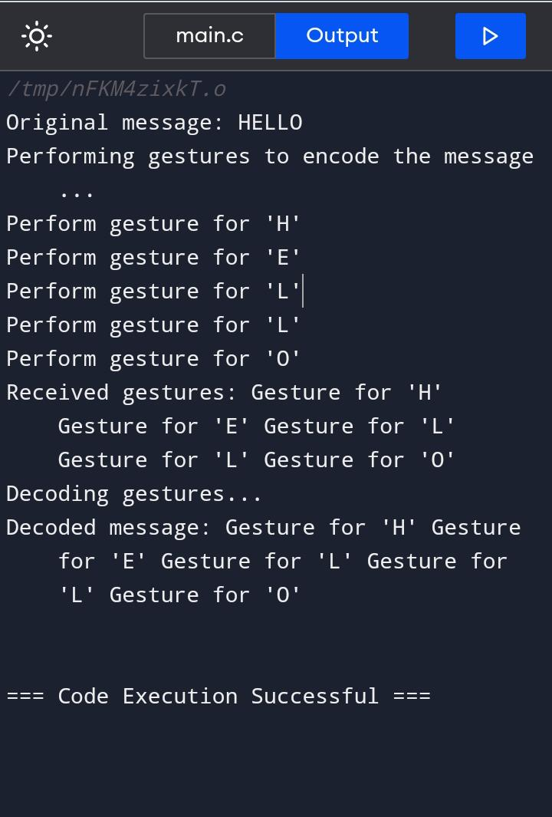
RESULTS
As you can see, the original message "HELLO" is encoded into gestures, and then the gestures are decoded back into the original message. The encoded gestures are simply printed out in the encode function, and in the decode function, the received gestures are printed as they are without any further processing.
In a real-world application, the encoding and decoding functions would perform more sophisticated operations, such as mapping each character to a specific gesture or vice versa, and handling the encoding/decoding process securely to ensure the integrity and confidentiality of the message. This basic example serves as a starting point for understanding the concept of gesture steganography.
Demo Link
3/21/2024 Annual Review

